Slide 1


UNIT 3: Home sweet home
My room, my freedom

Slide 2
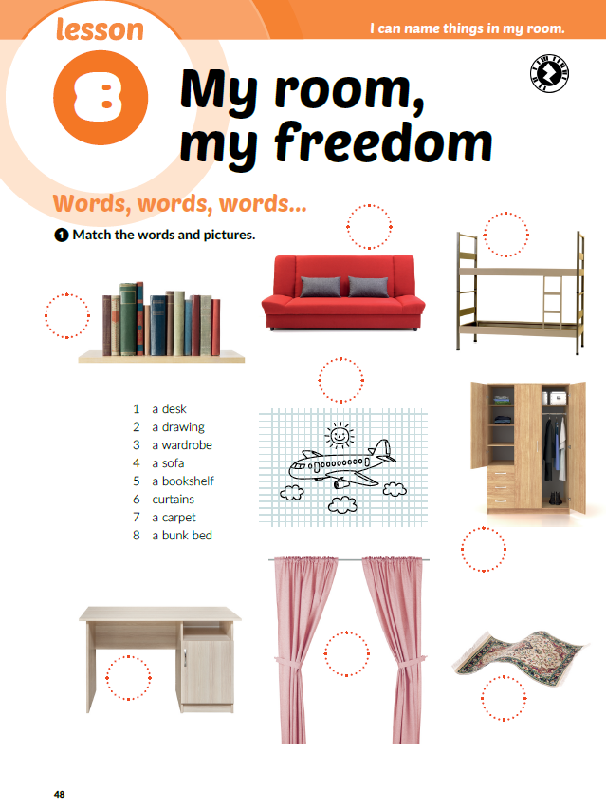

4
8
5
Click on the following link and choose Self check: Furniture. Look at the photos and name the pieces of furniture.
https://www.e-sfera.hr/dodatni-digitalni-sadrzaji/c88941a6-be98-4684-918b-19928e5c8c45/
2
In which room can you find these pieces of furniture?
What pieces of furniture is there in your room?
What do we use desk / a drawing /… for?
3
6
1
7

Slide 3
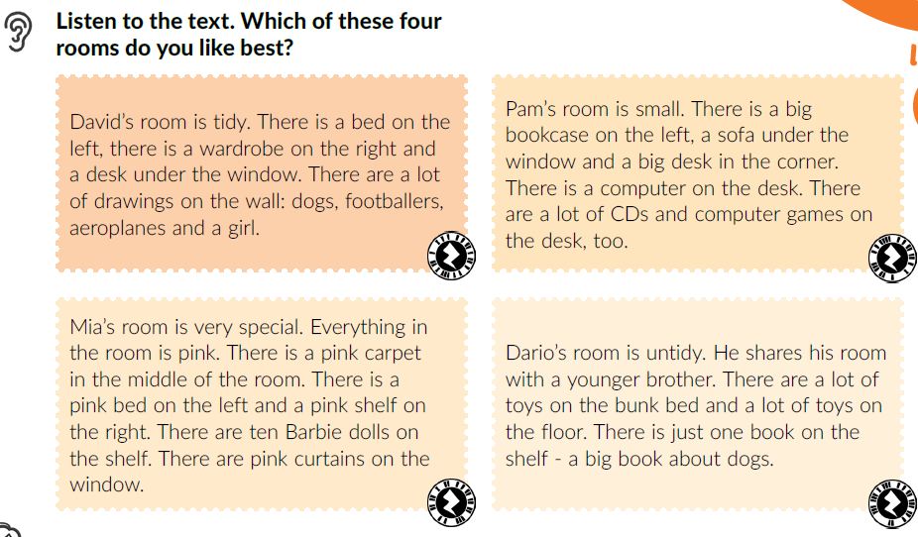

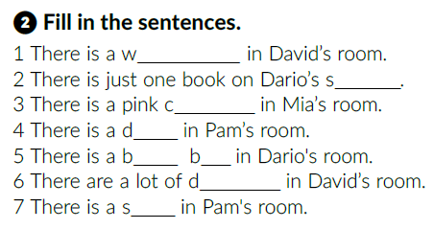
What do these words mean?
tidy =
untidy =
special =
wall =
floor =
uredan
neuredan
poseban
zid
pod
ardrobe
helf
arpet
esk
Listen again and fill in the sentences.
unk ed
rawings
ofa

Slide 4
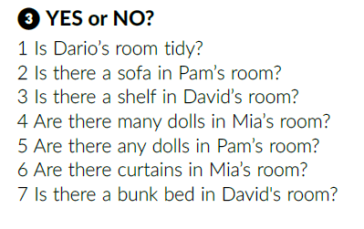
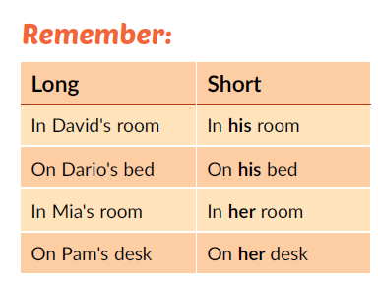
Yes.
Yes.
No.
Yes.
No.
Yes.
No.
Click on the following link and open the PowerPoint presentation Whose cat is it?
https://www.e-sfera.hr/dodatni-digitalni-sadrzaji/c88941a6-be98-4684-918b-19928e5c8c45/

Slide 5
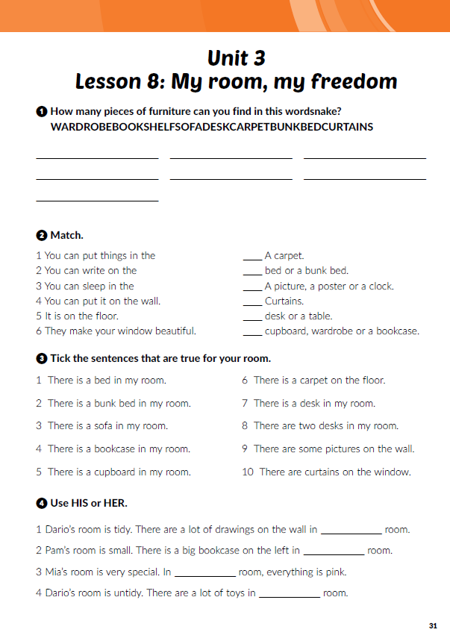
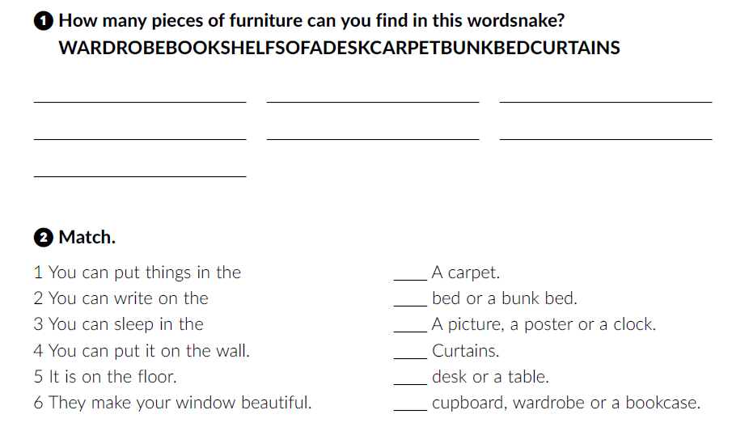
Workbook p. 31
wardrobe
desk
bunk bed
bookshelf
carpet
curtains
sofa
5
3
4
6
2
1

Slide 6
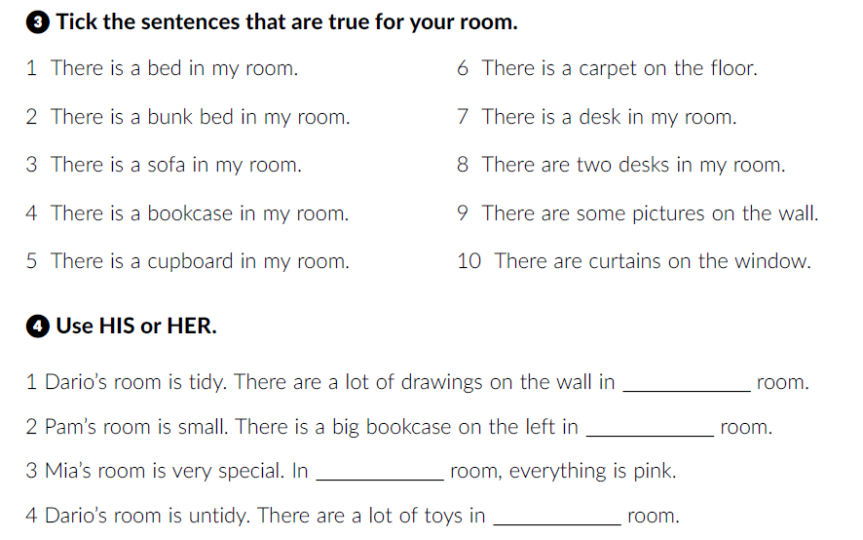
his
her
her
his

Slide 7
Click on the following link and choose Learn more. Read the text about Akira’s room (My favourite room).
https://www.e-sfera.hr/dodatni-digitalni-sadrzaji/c88941a6-be98-4684-918b-19928e5c8c45/
What pieces of furniture are there in Akira’s living room?
Is his living room tidy?

Slide 8
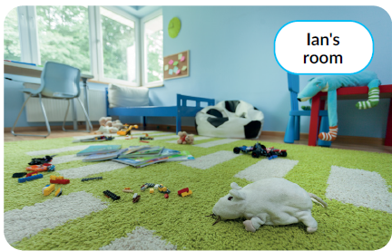
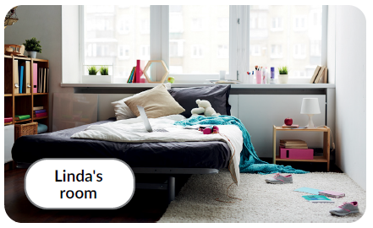
Look at the photos and describe the rooms.
Is your room similar to Akira’s room or Ian’s and Linda’s room?

Slide 9
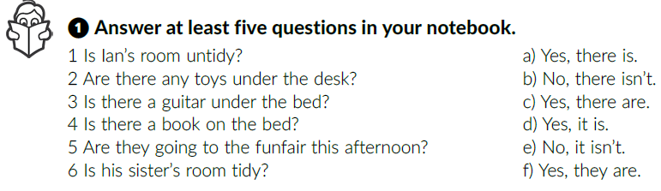
Textbook p. 50
Listen and match the questions and the answers.
d
c
b
a
f
d
What does the word funfair mean?
Zabavni park.
Click on the following link and open the PowerPoint presentation Funfair.
https://www.e-sfera.hr/dodatni-digitalni-sadrzaji/c88941a6-be98-4684-918b-19928e5c8c45/

Slide 10
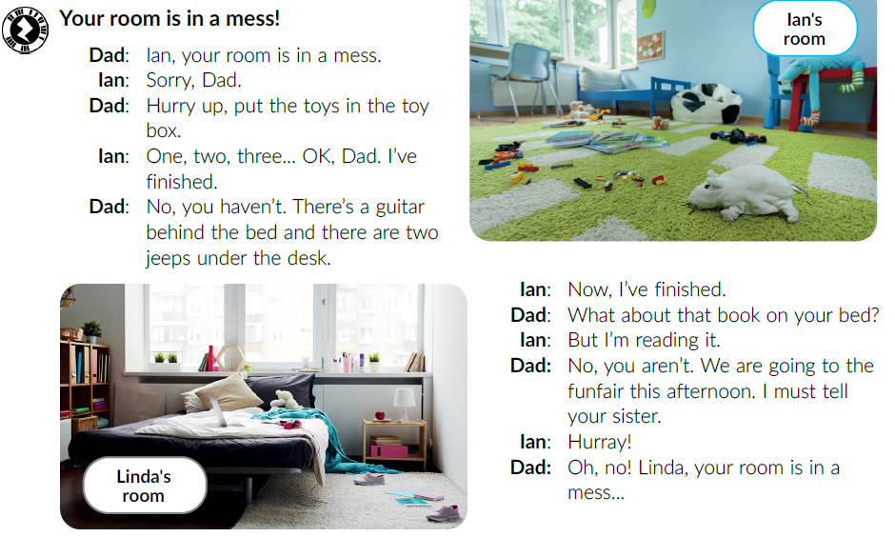
Read the text out loud.

Slide 11
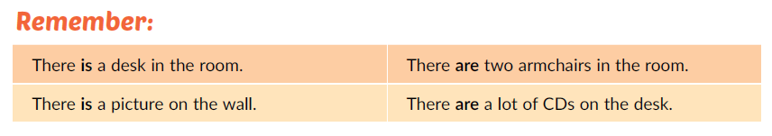
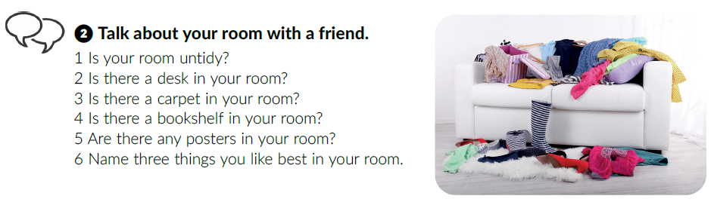
Work in pairs.

Slide 12
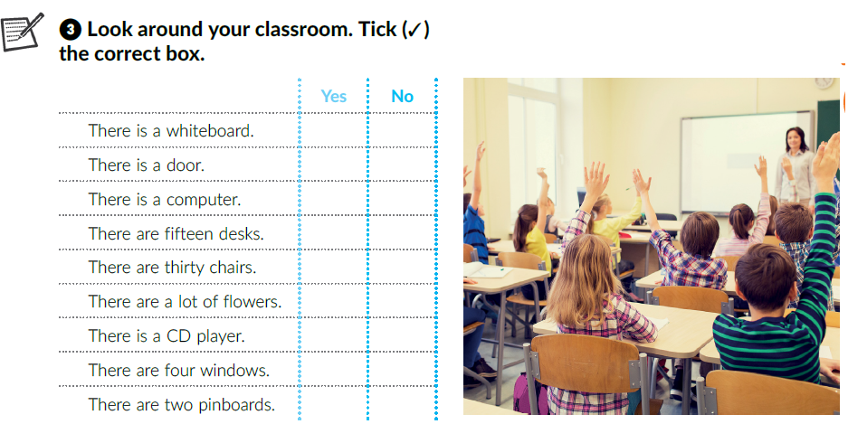
Use the expressions There is and There are and talk about your classroom.

Slide 13
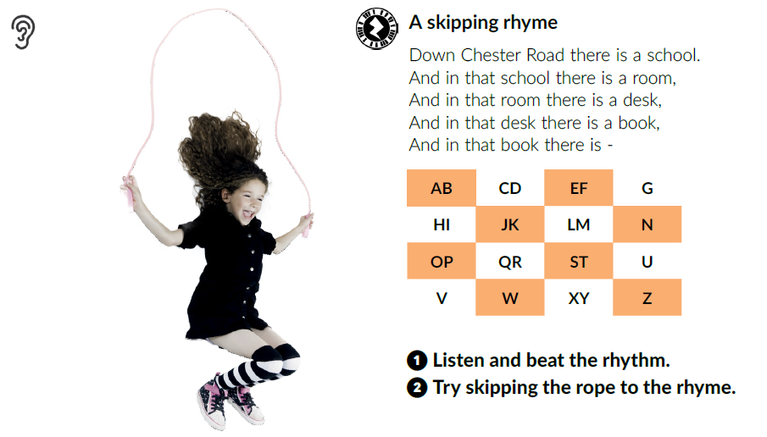

Slide 14
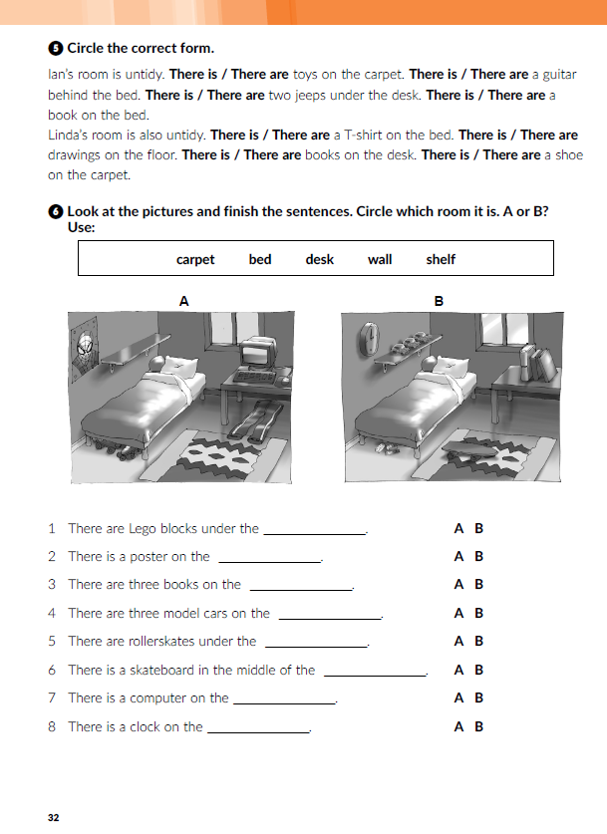
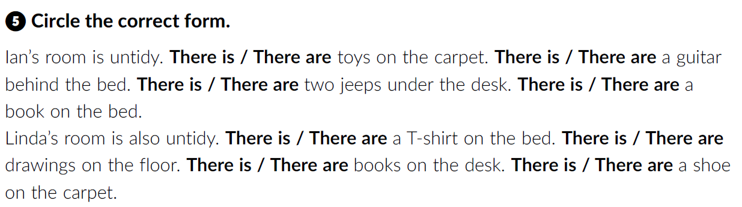
Workbook p. 32
Click on the following link and choose Self check: Furniture. Look at the photos and name the pieces of furniture.
https://www.e-sfera.hr/dodatni-digitalni-sadrzaji/c88941a6-be98-4684-918b-19928e5c8c45/

Slide 15
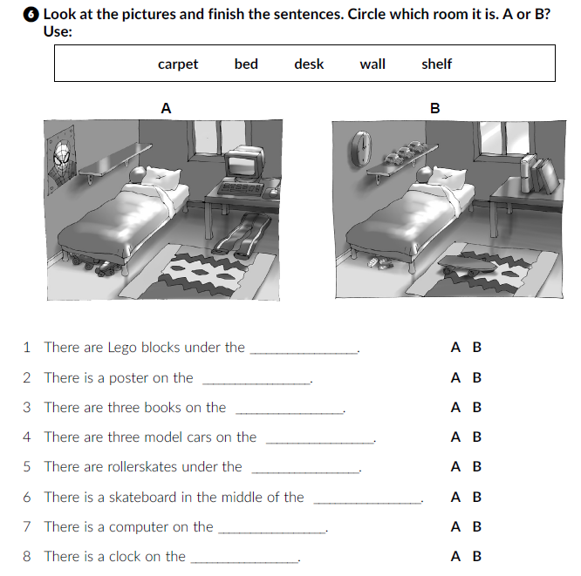
bed
wall
desk
shelf
bed
carpet
desk
wall

Slide 16
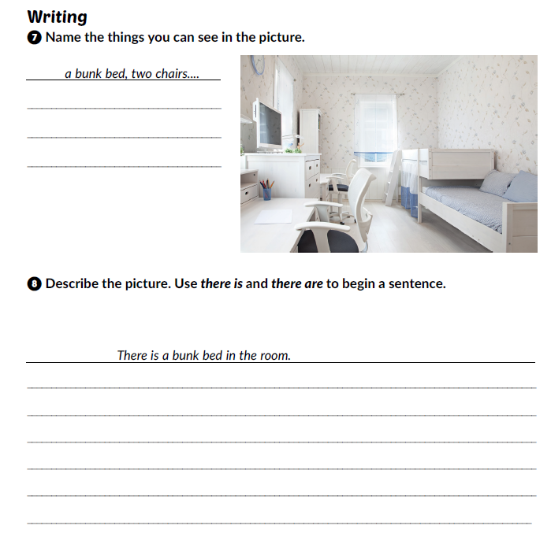

Workbook, p. 33
Book, page 51.

